Slide 1


THE JOURNEY OF WORDS:
HOW CULTURE SHAPES CONTENT DESIGN
Kapil Dwivedi
Senior Content Designer
Dentsu

Slide 2
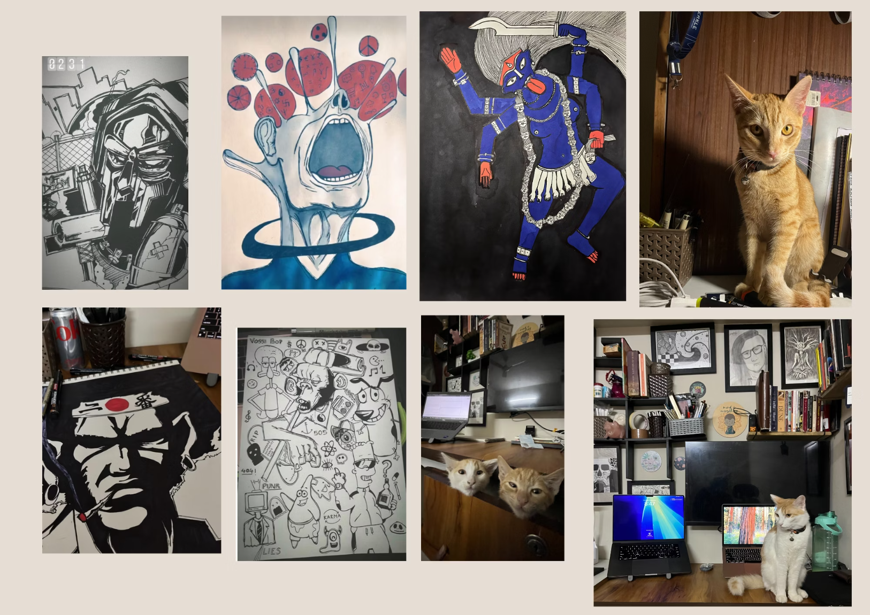
Hi! I am Kapil…
Senior Content Designer at Dentsu Global Services, words-and-culture nerd, and part-time scribbler of things.
FUN FACTS:
I’ve been playing video games for 25 years, everything from 8-bit classics to hyper-realistic AAA titles.
I’m a part-time illustrator who loves drawing characters and moments that don’t exist… yet.
I break down game-specific UX writing on my LinkedIn.
MY UNOFFICIAL QA TEAM:
Meet Milo and Zoey! They're always ready to protest any copy that doesn’t meet their mysterious internal standards.

Slide 3
What is Culture?
An Invisible Force / A secret ingredient that is omnipresent
Culture is deeply rooted in our interaction with digital products
Shared Foundation
Place of Origin
UX Impact
Culture encompasses shared beliefs, values, customs, and behaviors within a group or society.
Originates from a particular place
In UX writing, culture impacts how users perceive and interact with content

Slide 4

Cultural Differences
Jack vs Maverick: A Tale of Two Worlds
Variations in shared beliefs, values, customs, and behaviors that exist between different groups or societies.
Meet Samurai Jack and Maverick, embodying Japanese subtlety and American directness.

Slide 5

How do religious beliefs shape banking practices?
Consider how deeply held spiritual and ethical frameworks can shape financial regulations, product offerings, and customer interactions around the globe.

Slide 6


Religious Influence on
Banking Practices
Ethical Considerations
Financial Products & Services
Different religions have specific ethical guidelines that shape financial transactions.
Religious values often guide product offerings and customer preferences, reflecting a deeper moral framework.
Example: Islamic banking prohibits interest (Riba) and adheres strictly to Sharia principles, fostering fairness and equity.
Example: In regions influenced by Sanatana Dharma, factors like auspicious dates, ethical investing, and the principles of Dharma (righteousness) impact financial decisions.

Slide 7
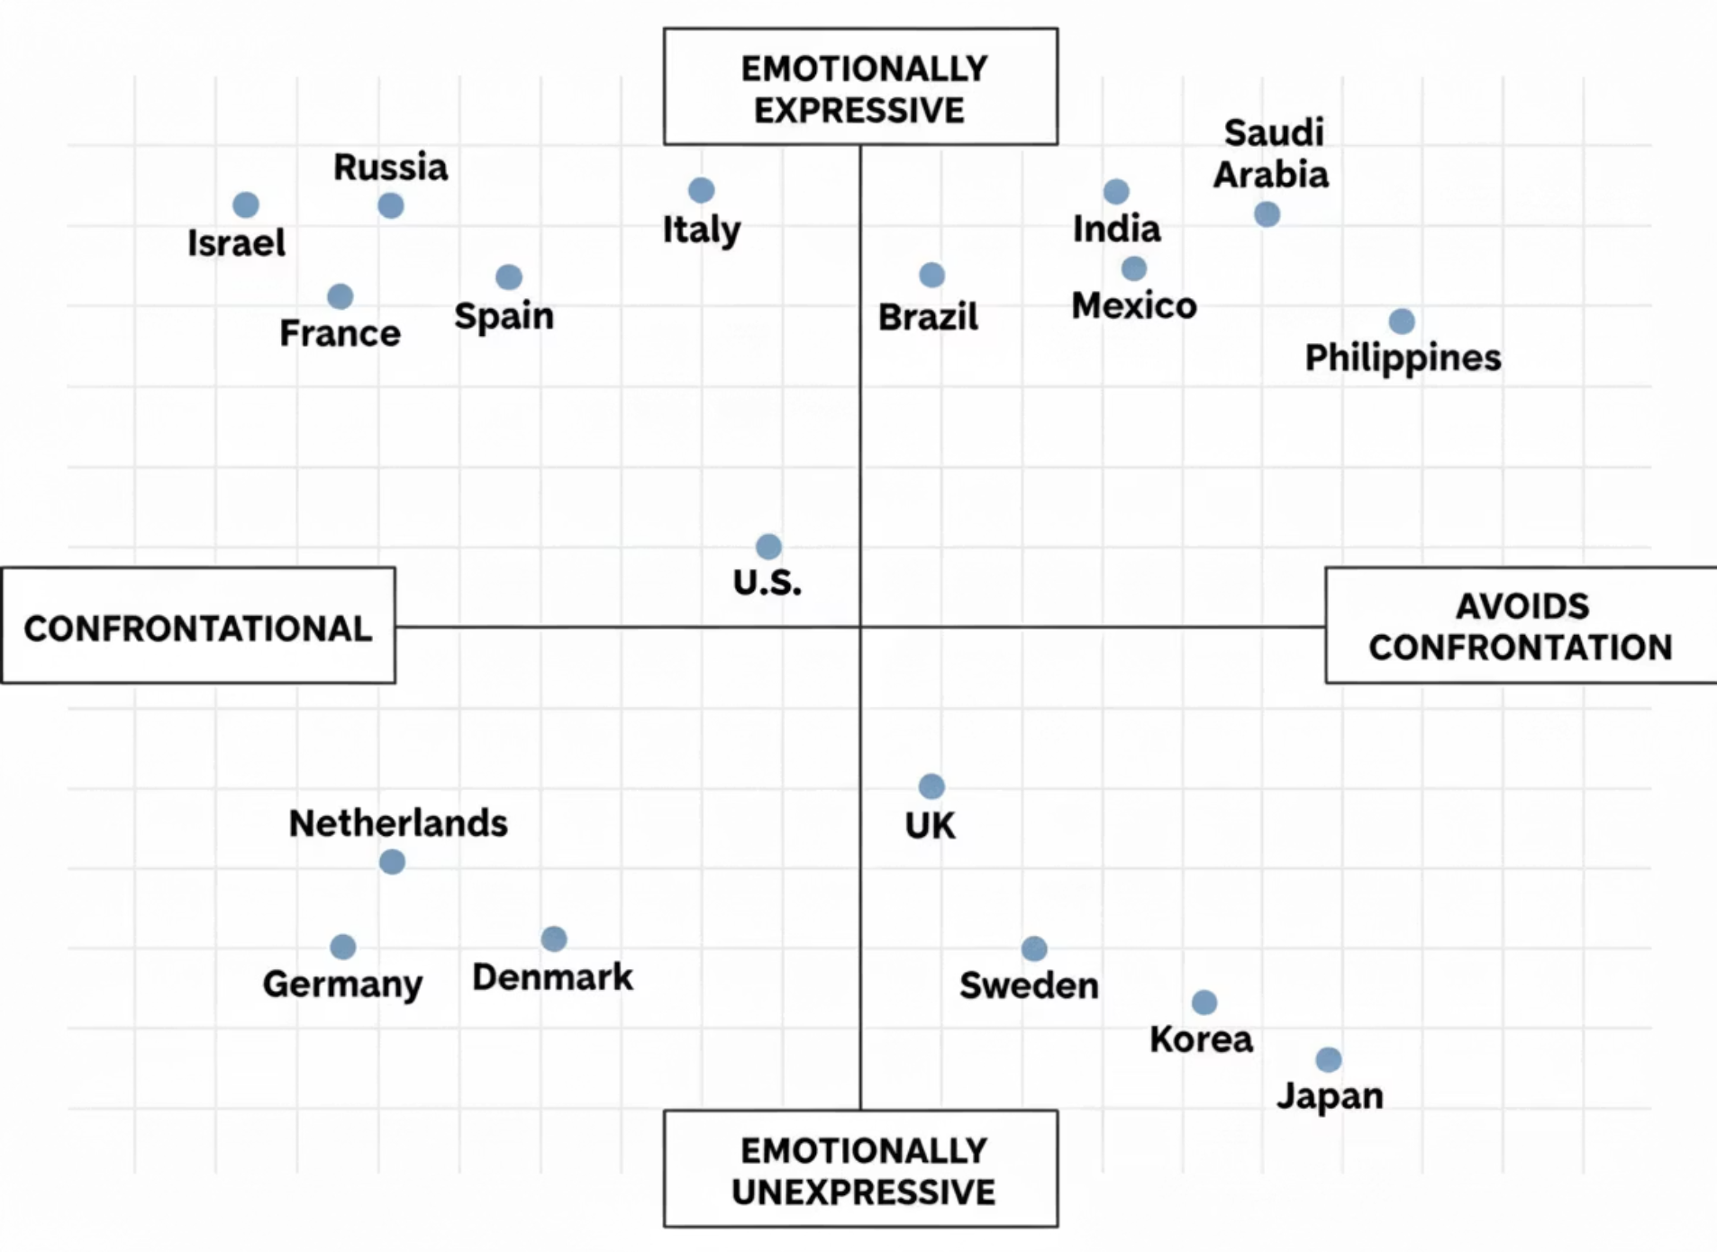
Erin Meyer's Culture Map
Erin Meyer's work on cultural differences highlights variations in confrontation and emotional expression.

Slide 8
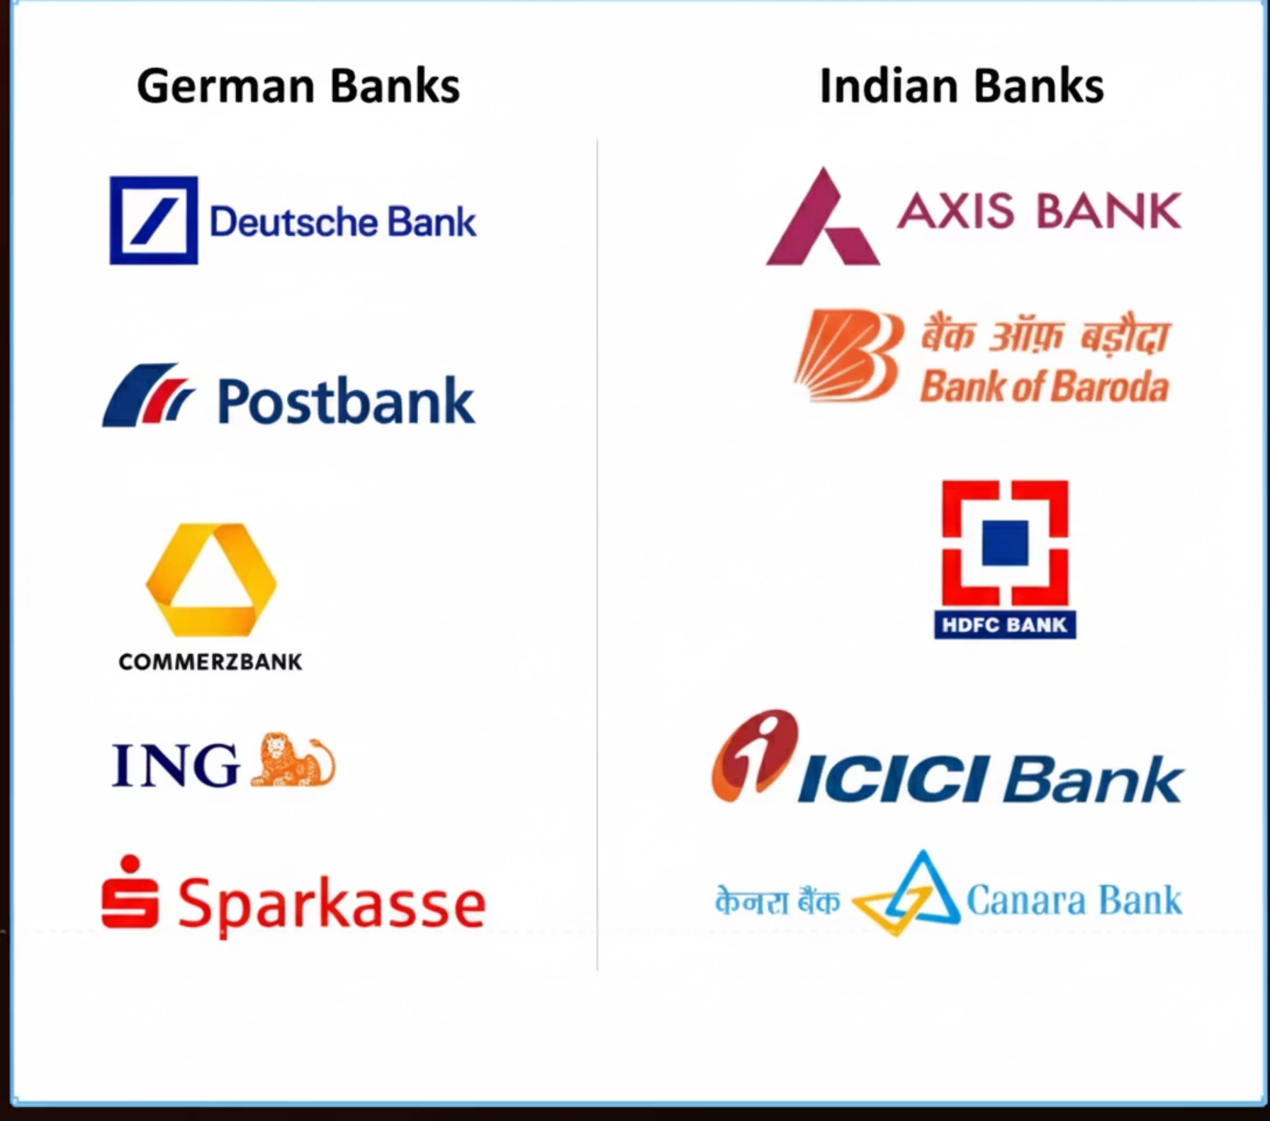
Cross-Cultural Analysis
List of banks featured in the analysis

Slide 9


INSIGHT 01
Number of Options
Reflecting Cultural Preferences in Content Design
German Banking Websites
Indian Banking Websites
Emphasize simplicity with 3–5 options, focusing on clarity and efficiency. Simple design & writing. Noticeable use of white-space.
Feature a broader range of options, reflecting a cultural preference for variety and detailed information. Extensive footer and overview sections..

Slide 10
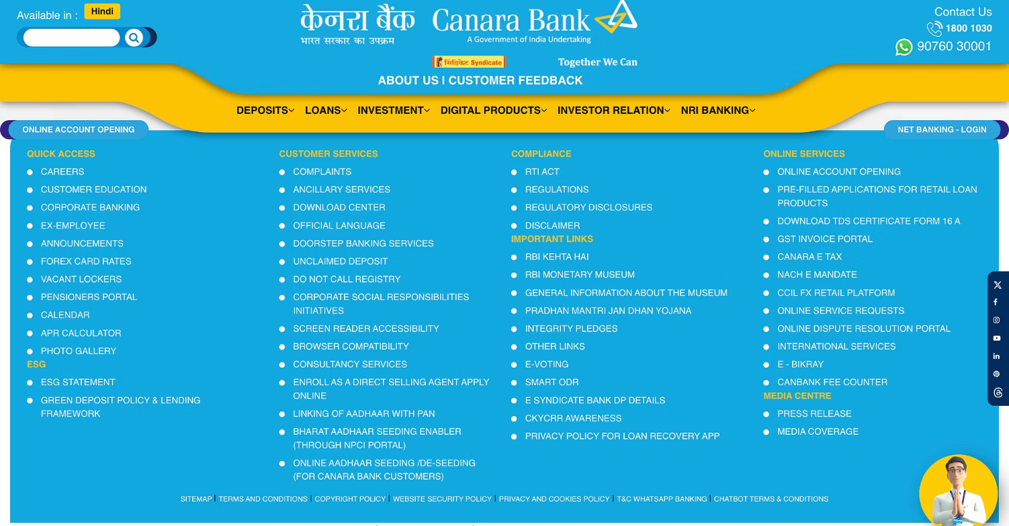
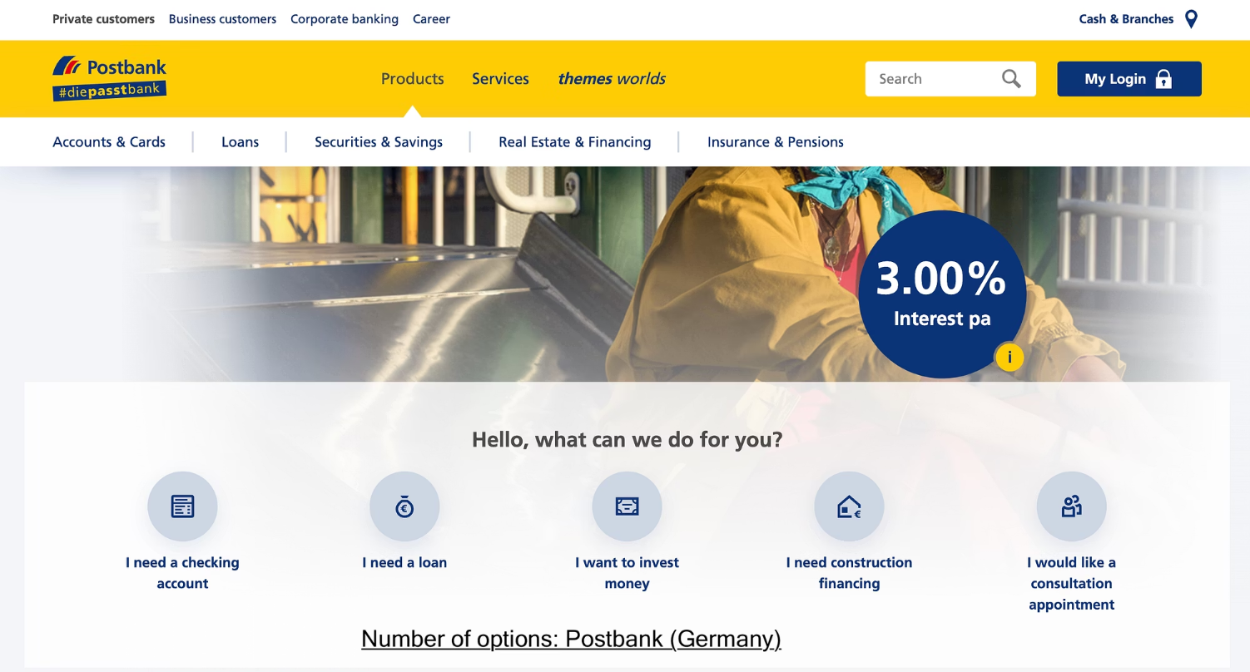
Examples
vs

Slide 11
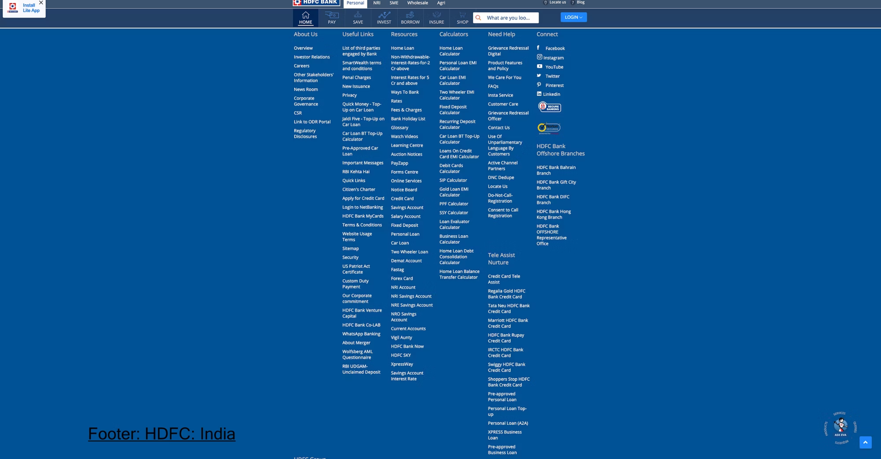
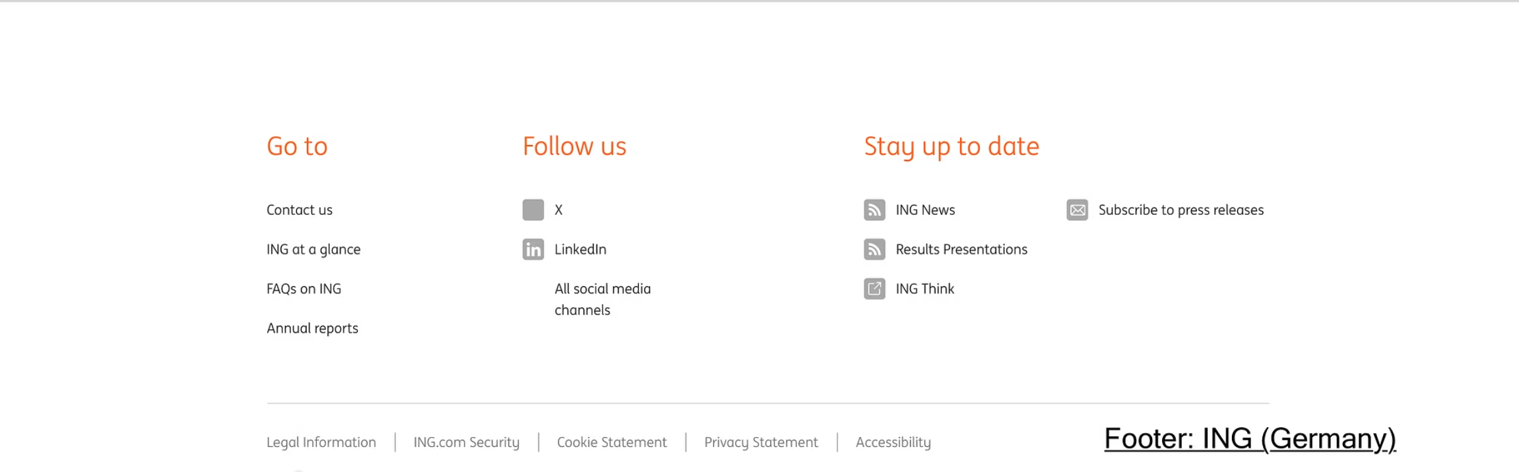
Examples
vs

Slide 12
INSIGHT 02
Information Architecture
Content Presentation and Cultural Preferences
German Banking Websites
Indian Banking Websites
More streamlined, with focused content and
minimal multimedia.
Rich in content, with extensive self-help guides, numerical tools, multimedia and educational resources.

Slide 13
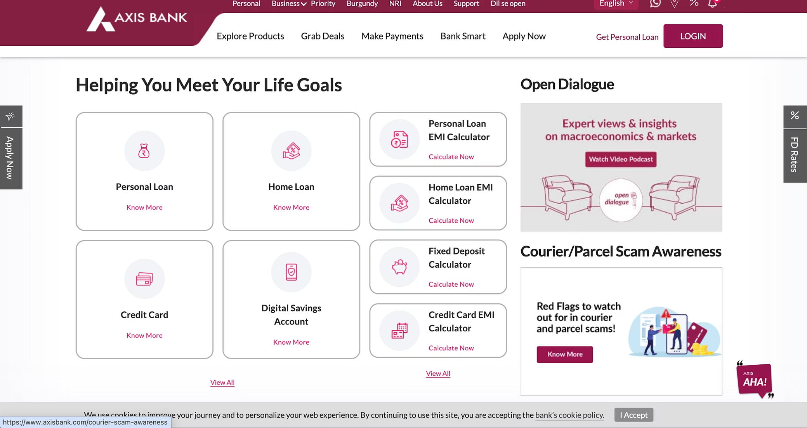
Examples
vs

Slide 14
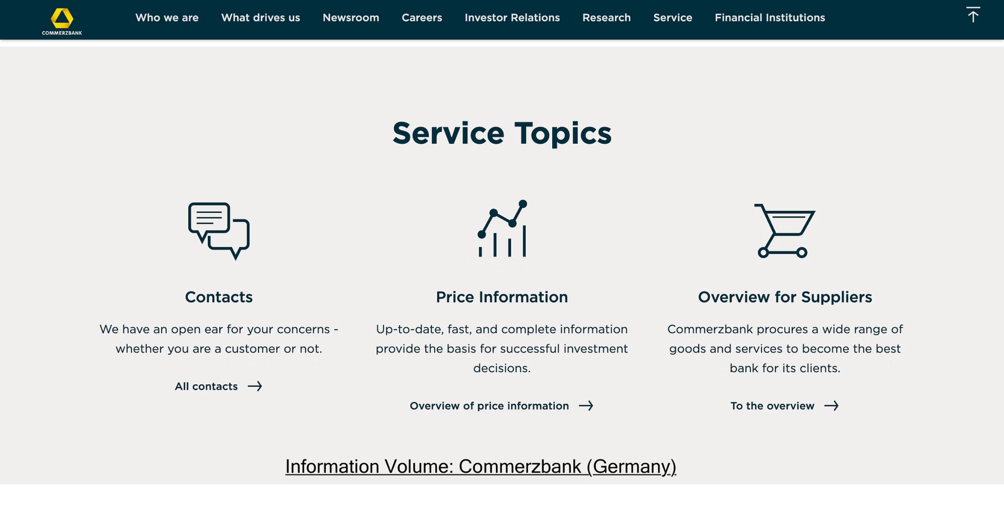
Examples
vs

Slide 15
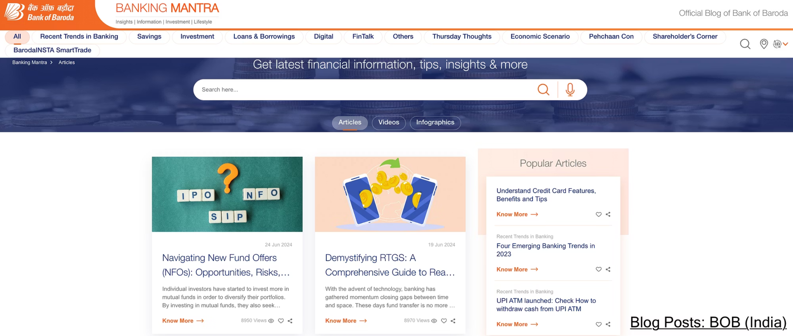
Examples
vs

Slide 16
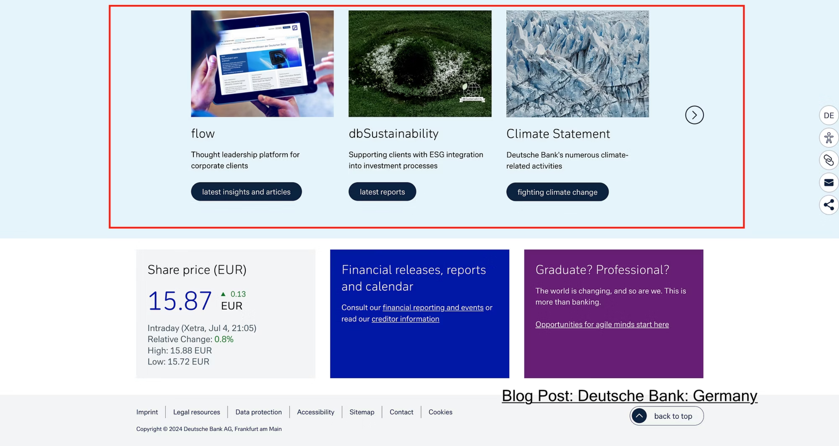
Examples
vs

Slide 17
INSIGHT 03
Voice and Tone
Emotional vs. Practical Communication
German Banking Websites
Indian Banking Websites
Use a subtle, practical tone with a focus on clarity and efficiency.
Emphasize an emotional tone, focusing on personal connection and care.

Slide 18
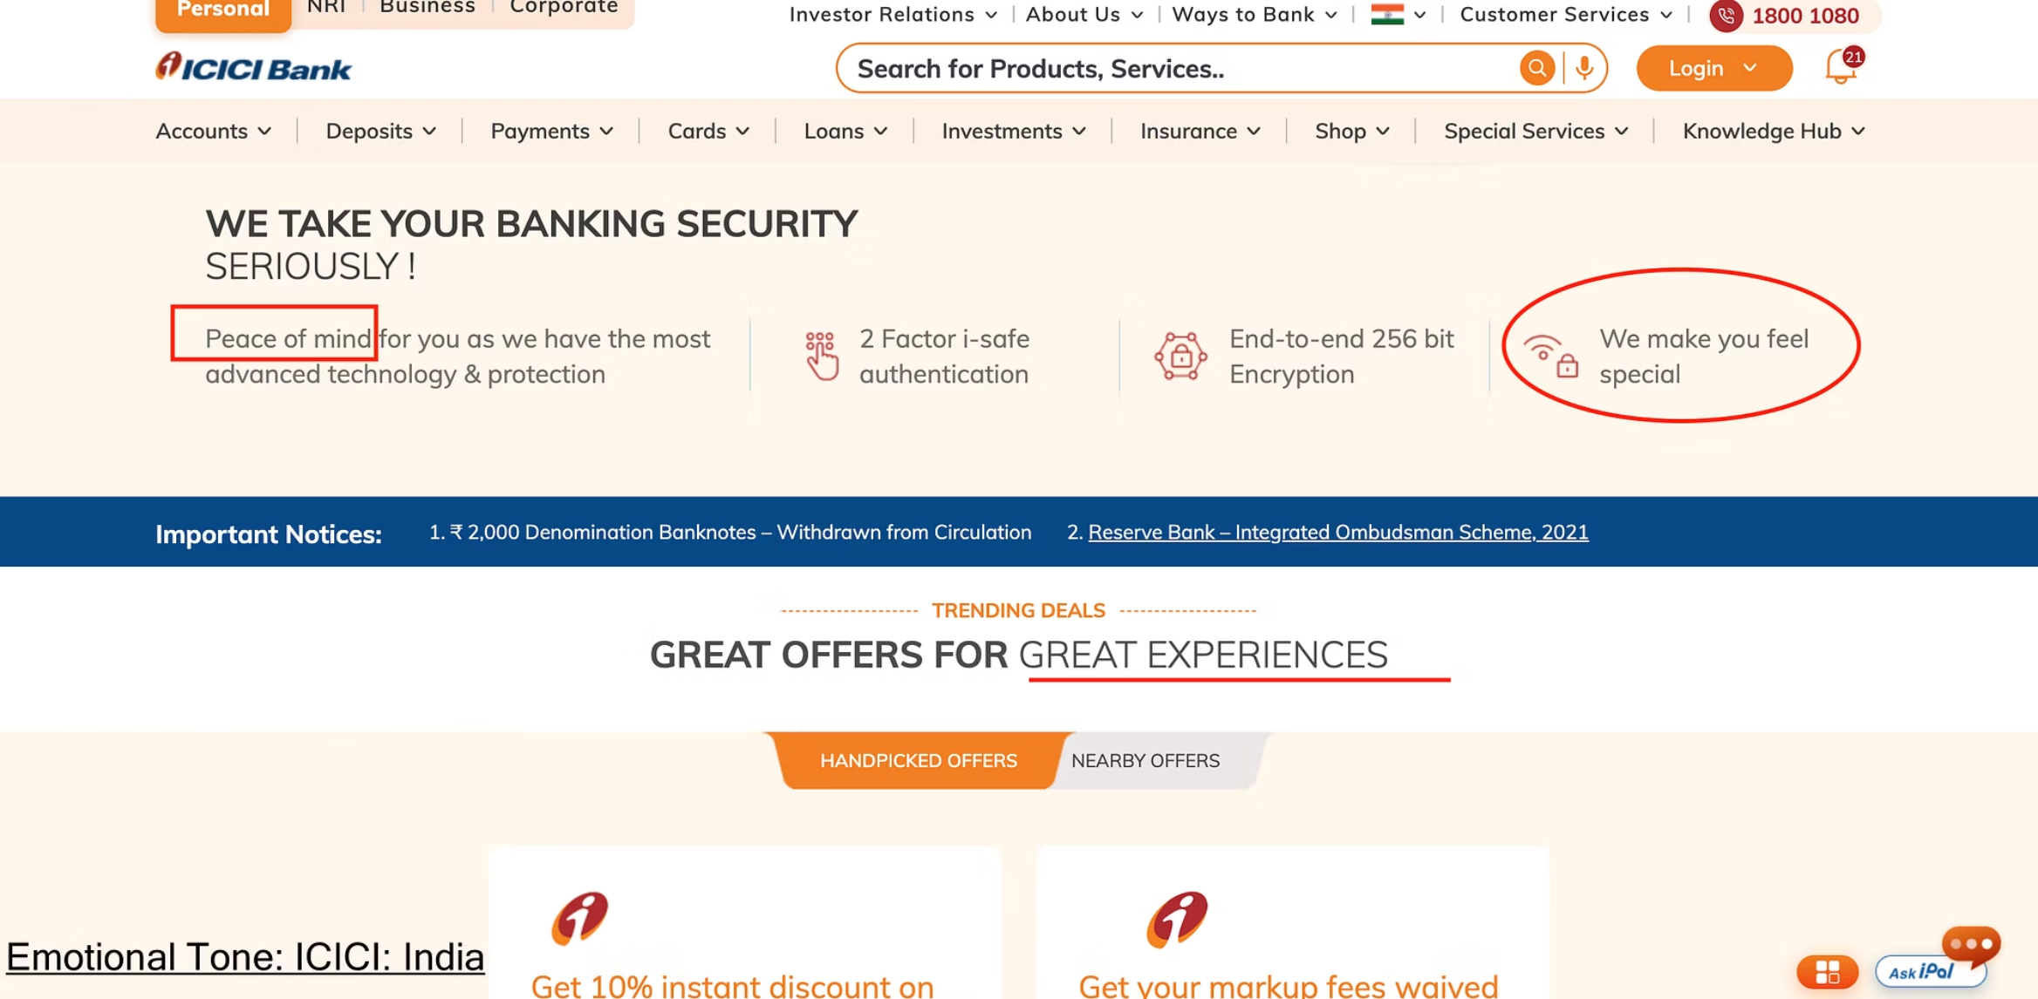
Examples
vs

Slide 19
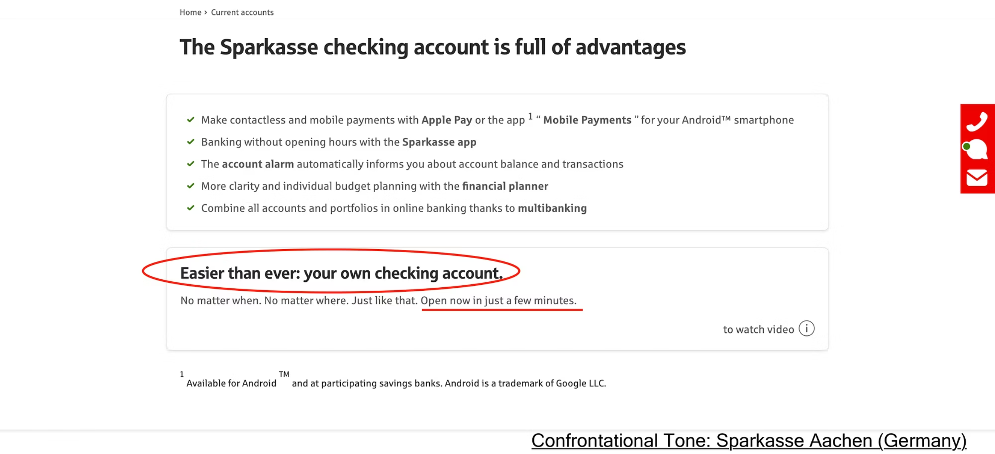
Examples
vs

Slide 20
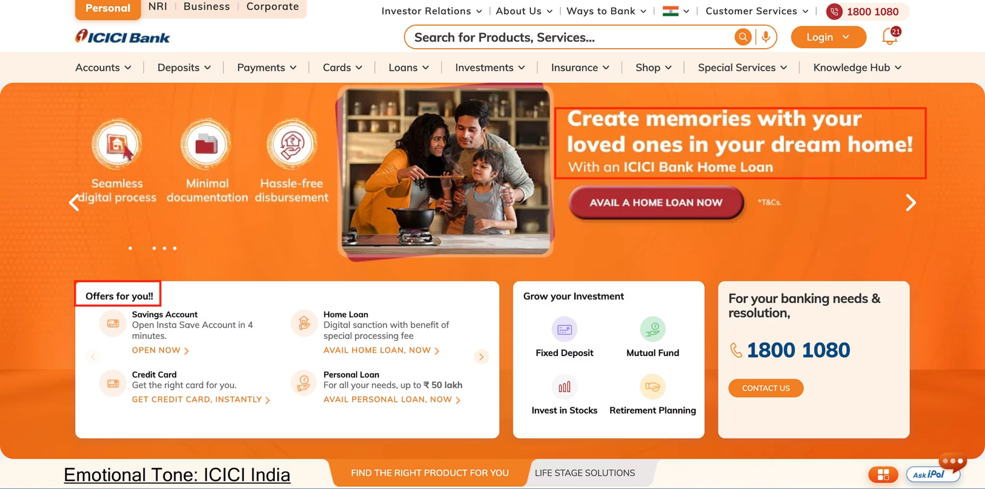
Examples
vs

Slide 21
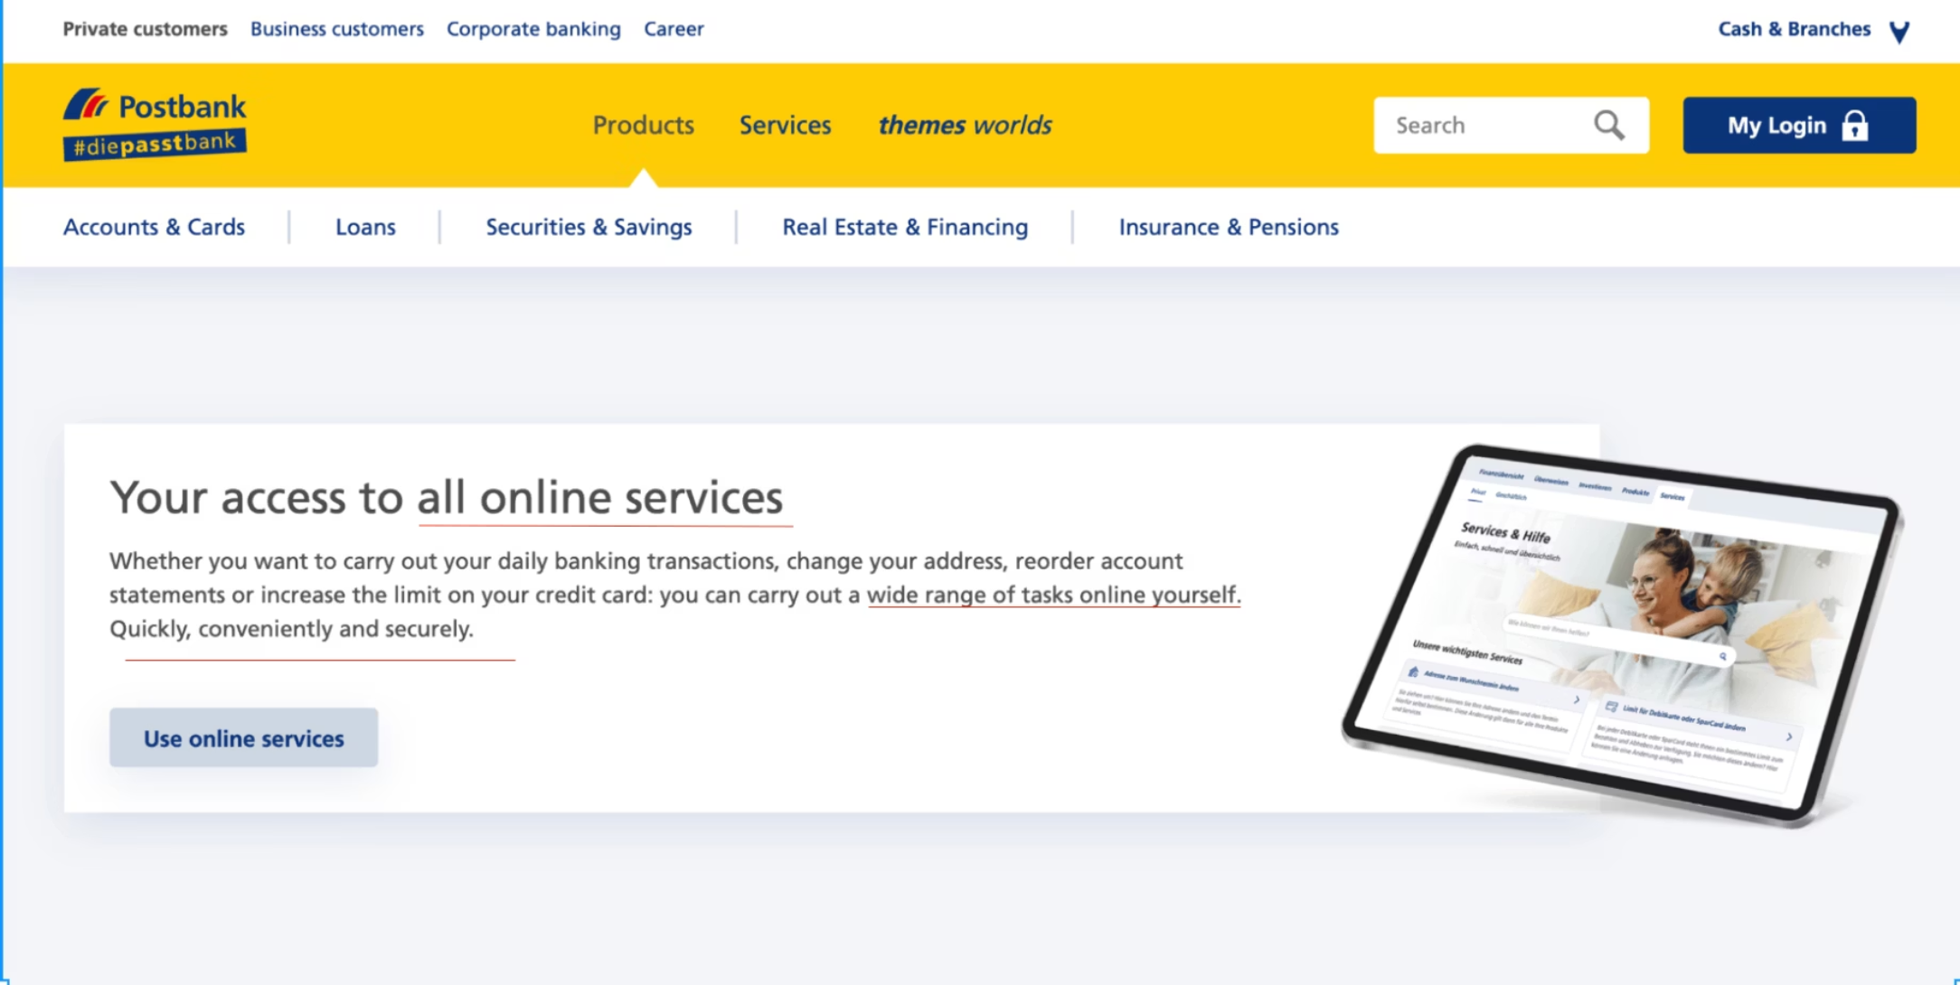
Examples
vs

Slide 22






Culture-Led Content Design
Collaborate
Clarity
Research
Diversified Sources
Use of Tools & Frameworks
Thoughtful Integration

Slide 23
"Think like a wise man but communicate in the language of the people."
— William Butler Yeats

Slide 24







Thank You!
Email
kdwivedi45@gmail.com
LinkedIn
Kapil Dwivedi
Website
www.scribblemonkk.com
Phone
+91-8574679746

